Slide 1
What is Technology?
Levi & Sarah
Notes:
Levi and Sarah

Slide 2
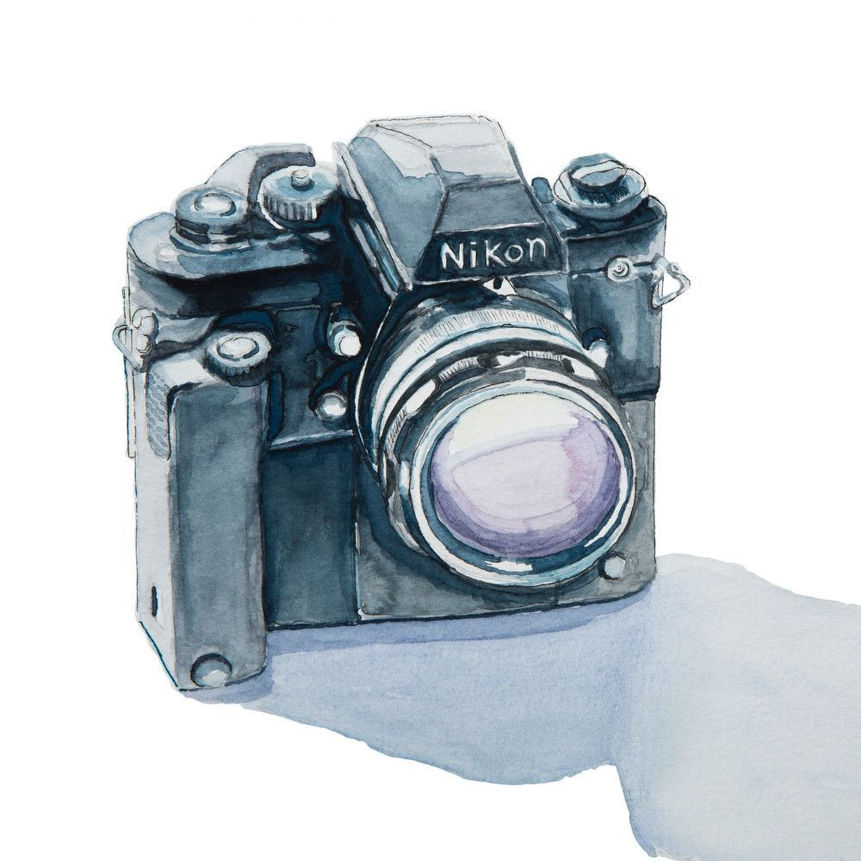
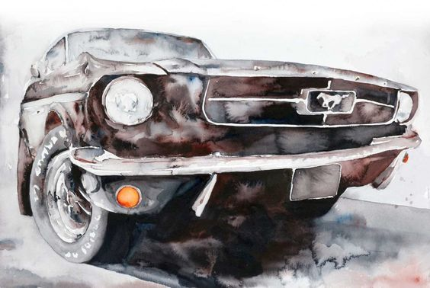
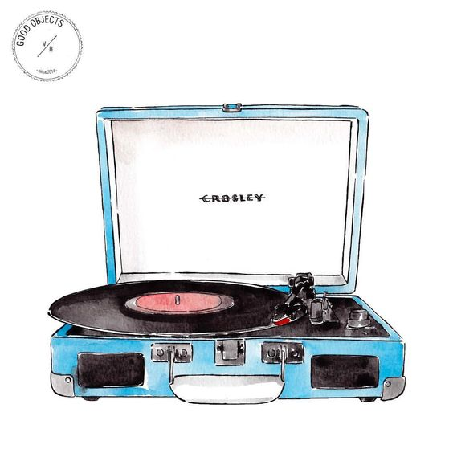
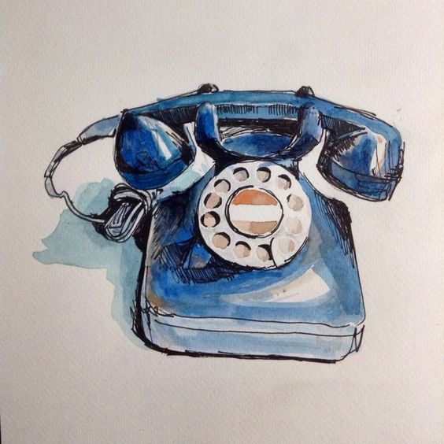
Image sources: https://www.pinterest.com/pin/30891947415559143/ https://www.google.com/search?safe=active&tbm=isch&q=old+telephone+watercolor&imgrc=U6RgVuYf4oE2bM:&cad=h#imgrc=B_YiaDGC0UXEWM:
Notes:
Levi photo source: pinterest

Slide 3
History of the use of the Word
Ancient Times:
Τεκνη - “craft, skill, or art” and λογια - “systematic study of a subject”
Referred to a skill, a specialization, of making something
1800s:
Industrial Revolution
Understanding how these machines worked led to the study of these machines also being technology.
Notes:
Levi

Slide 4
History of the use of the Word
1900s and now:
Referring to the tools used to make things and the things made by the tools.
Technology now refers to:
The skill
The study
The tools
The products
Notes:
Levi

Slide 5
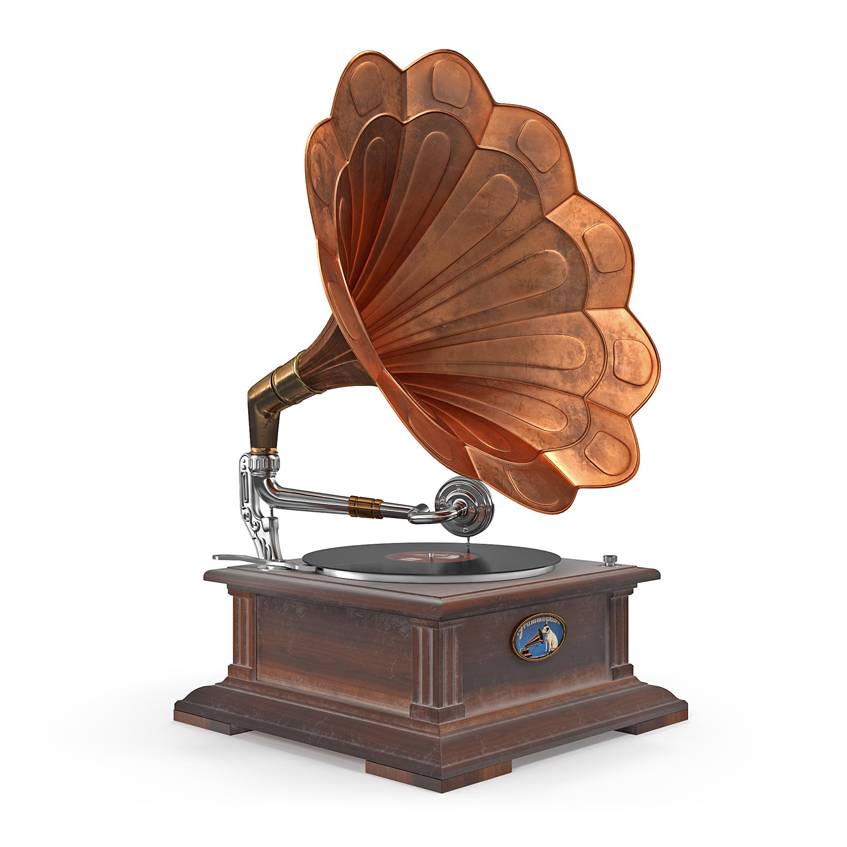
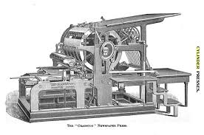
Old vs. New
Before 1650:
Very slow rate of technological advancement
1650-1850:
Building machines stronger and faster than humans (trains, printed books)
1850-1950:
Building tools that replicated human senses (photograph, phonograph, telegraph)
Phonograph image source: https://3docean.net/item/old-classical-phonograph-3d-model/20906000
Printing press image source: http://www.alignment2012.com/Cranston.html
Notes:
Levi

Slide 6
Kline’s 4 Layers of Technology

Slide 7
Kline’s 4 Layers of Technology
Hardware -- the things man creates
Notes:
Sarah

Slide 8


https://www.pinterest.com/pin/AYXa9iTUwhpgKhl3LYsu7GAWdDkHe7kGxzcP6JyXp_8hOWMBLHcf2Ds/
Notes:
Source: pinterest

Slide 9
Kline’s 4 Layers of Technology
Hardware -- the things man creates
Manufacturing -- what man uses to create those things

Slide 10
Kline’s 4 Layers of Technology
Hardware -- the things man creates
Manufacturing -- what man uses to create those things
Methodology -- the know-how

Slide 11
Kline’s 4 Layers of Technology
Hardware -- the things man creates
Manufacturing -- what man uses to create those things
Methodology -- the know-how
Social Usage -- rules

Slide 12
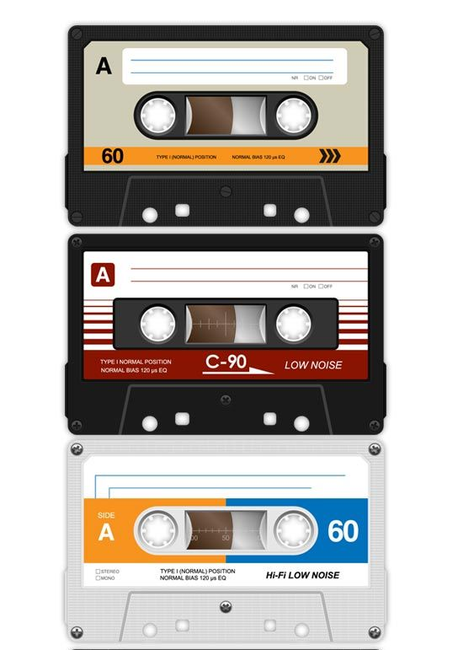

https://www.pinterest.com/pin/25403185371410787/
https://www.google.com/search?q=spotify+icon&source=lnms&tbm=isch&sa=X&ved=0ahUKEwiPvZ_14t3dAhXuYt8KHVBlDB0Q_AUIDigB&biw=1260&bih=550#imgrc=1Hz2uqVC3iBYpM:
Notes:
Source: pinterest, google images

Slide 13
Simple Definition please??
“The human activity of using tools to transform God’s creation for practical purposes”
Notes:
Sarah

Slide 14
Simple Definition please??
“The human activity of using tools to transform God’s creation for practical purposes”
Notes:
Sarah

Slide 15
Simple Definition please??
“The human activity of using tools to transform God’s creation for practical purposes”
Notes:
Sarah

Slide 16
Simple Definition please??
“The human activity of using tools to transform God’s creation for practical purposes”
Notes:
Sarah

Slide 17
What I learned
Technology affects people and isn’t just a term for computers/phones but the action of using what God gave us and using it well.

